Slide 1
JetBot powered by Jetson Nano
2022 Mike Soniat

Slide 2
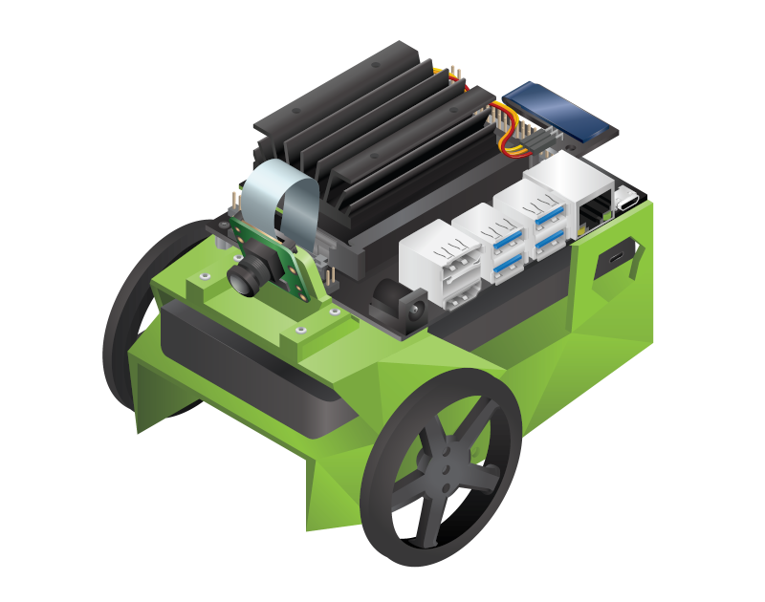
JetBot JetBot is an open-source robot based on NVIDIA Jetson Nano. https://jetbot.org

Slide 3
Project
Build an autonomous robot that uses machine vision and machine learning to roam around its environment
Use the Jetson Nano Developer Kit as a platform
Use NVIDA’s JetBot library for controlling the robot
Use PyTorch library for deep learning
Use TensorFlow API for object detection
Use OpenCV library for computer vision
Experiment with
Basic Motion
Gamepad Control
Object Following
Collision Avoidance
Road Following

Slide 4



The JetBot image contains Open-Source Python Libraries for Machine Learning, AI, and computer vision

Slide 5
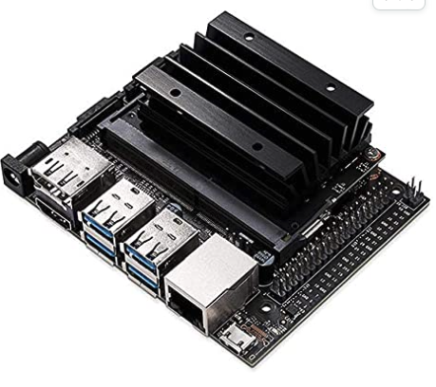
NVIDIA Jetson Nano
This developer kit is a small, powerful computer that lets you run multiple neural networks in parallel for applications like image classification, object detection, segmentation, and speech processing. All in an easy-to-use platform that runs in as little as 5 watts.

Slide 6
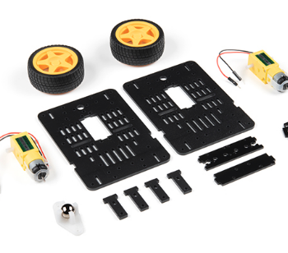
JetBot Chassis Kit V2
The JetBot chassis kit comes with two motors, two wheels, frames, a ball caster and all assembly materials like screws and standoffs. There are also the included materials for an optional camera mount to be added to your chassis.
Optionally, you can 3D print the chassis and purchase the motors, wheels, and other hardware separately.

Slide 7
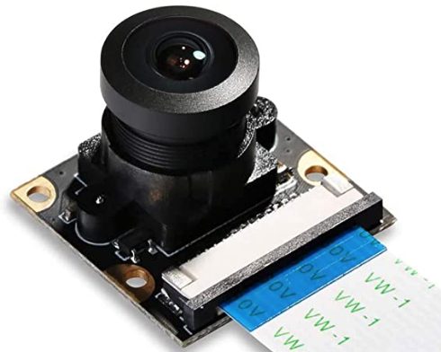
Camera Module
SainSmart IMX219 for Jetson Nano
The 160-degree wide-angle lens can capture a large area of the scene within a short shooting distance and is suitable for photographing large scenes such as architecture and scenery.
This camera module is designed for NVIDIA Jetson Nano Board and Raspberry PI CM3.
The camera is capable of 3280 x 2464 pixel static images, and also supports 1080p @ 30fps, 720p @ 60 fps and 640 x 480 p 60/90 video recording.

Slide 8
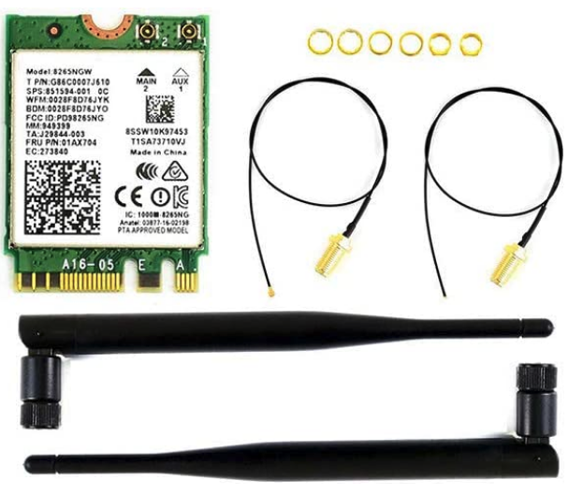
Wi-Fi Module
Wireless-AC8265 is a dual-mode wireless NIC module applicable for NVIDIA Jetson Nano Developer Kit.
Supports 2.4GHz/5GHz dual-band WiFi and Bluetooth 4.2.
WiFi protocol: 802.11ac; Bluetooth version: 4.2; NIC interface: NGFF (M.2)
Chip: Intel 8265AC; Bands: 2.4GHz / 5GHz; Speed: 300Mbps / 867Mbps
Antenna interface: IPEX connector; Supported OS: Linux, Windows 10/8.1/8/7; Dimensions: 22mm × 30mm × 2.4mm
NOTE: You can optionally use a USB Wi-Fi Dongle

Slide 9
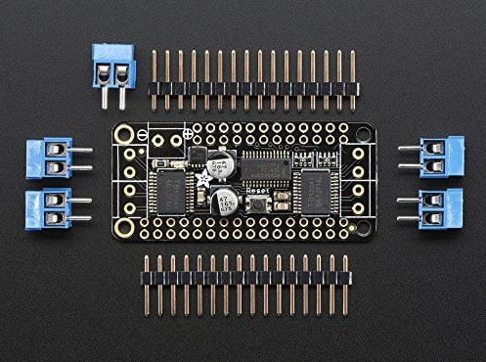
Motor Controller
DC Motor and Stepper FeatherWing Add-on For All Feather Boards
Completely stackable design: 5 address-select jumper pads means up to 32 stackable wings: that's 64 steppers or 128 DC motors!
Polarity protected 2-pin terminal block and jumper to connect external power, for separate logic/motor supplies
4 full H-Bridges: the TB6612 chipset provides 1.2A per bridge with thermal shutdown protection, internal kickback protection diodes.

Slide 10
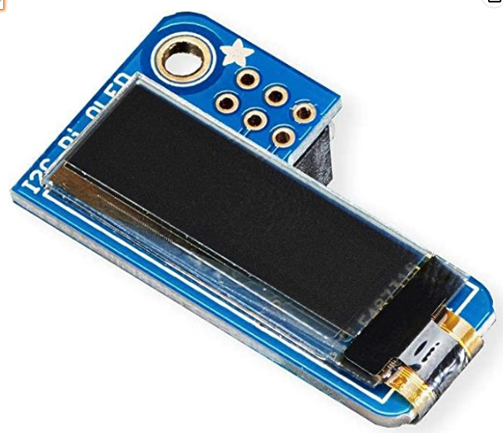
PiOLED Display
Adafruit [3527 PiOLED - 128x32 Monochrome OLED Add-on for Raspberry Pi.
Uses only the I2C pins so you have plenty of GPIO connections available for buttons, LEDs, sensors, etc.
Made of 128x32 individual white OLED pixels and because the display makes its own light, no backlight is required.

Slide 11
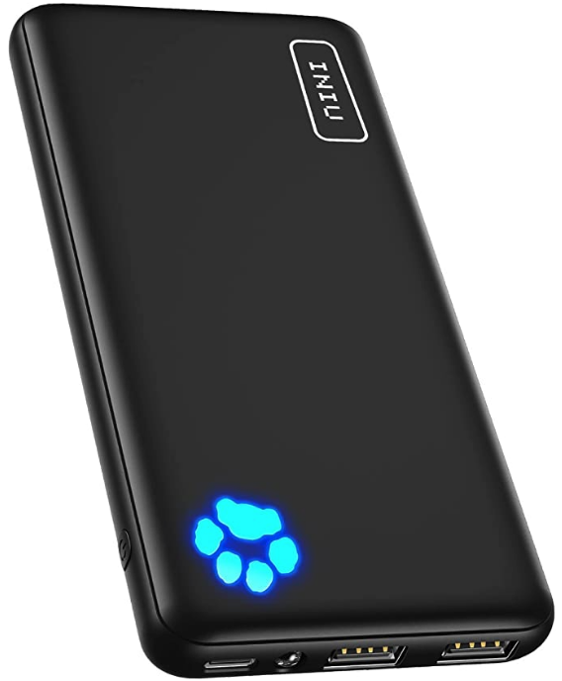
Dual Power Bank
INIU Portable Charger
Dual 3A USB C ports
10000mAh capacity
Micro USB charging port

Slide 12
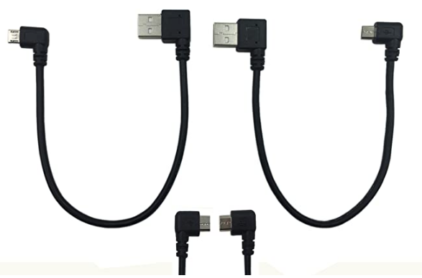
Cable Combo Kit
9 Inch Micro USB Cable Combo
Left & Right-Angle Micro USB 5 Pin Male to USB 2.0 Type A Right Angle Male
Data Sync and Charge Cable (Black)(2-Pack) R

Slide 13
Component List
Part | Source | Price
Jetson Nano | NVIDIA/Amazon | $ 149.00
JetBot Chassis Kit v2 | Sparkfun | $ 16.50
Camera Module | Amazon | $ 21.99
Wi-Fi Card (or Dongle) | Amazon | $ 21.99
Motor Controller | Amazon | $ 23.67
PiOLED Display | Amazon | $ 13.23
Dual Power Bank | Amazon | $ 19.99
Micro SD card (64GB) | Amazon | $ 10.00
Cable Combo Kit | Amazon | $ 8.99
Total Cost = $285

Slide 14
Getting Started

Slide 15
Initial Setup and Connect to Wi-Fi
1. Install the Wi-Fi card or plug the Wi-Fi Dongle into the Jetson Nano.
2. Download the pre-built JetBot SD card image* and flash to a micro SD card (64GB recommended)
3. Insert the SD card, connect HDMI monitor, USB keyboard and mouse, and power up the Jetson Nano.
4. Login with user = jetbot and password = jetbot
5. Connect the Jetson Nano to your Wi-Fi SSID
6. Power down the Nano from the Terminal with “sudo shutdown now” and disconnect all cables.
* NOTE: I had trouble with the newer images. I settled on JetPack version 4.3.

Slide 16
Assembly

Slide 17
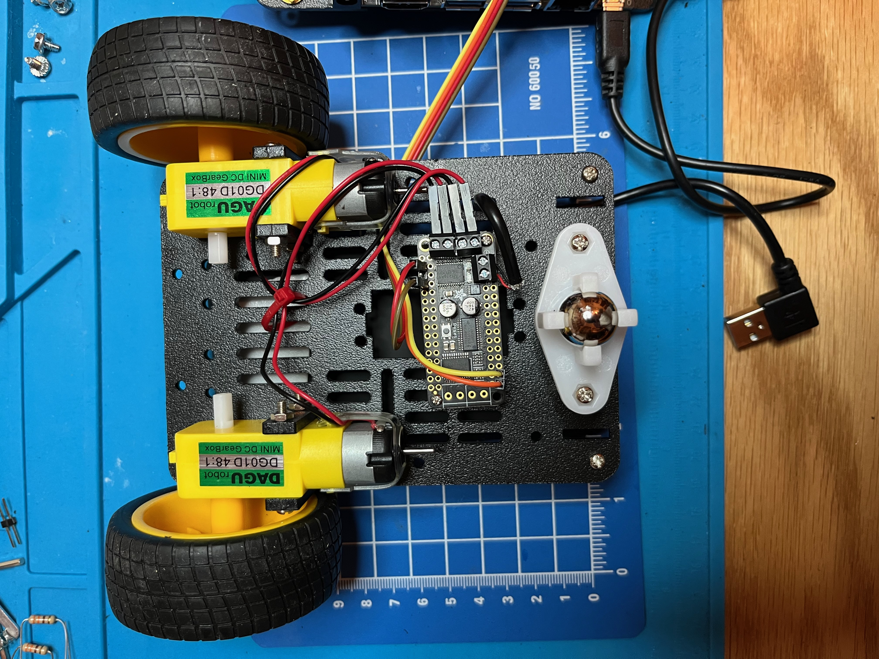
Bottom View
Install motors as shown using mounts and screws supplied in kit.
Mount motor control board to bottom of chassis using plastic standoffs and screws.
Mount caster ball and housing as shown.

Slide 18
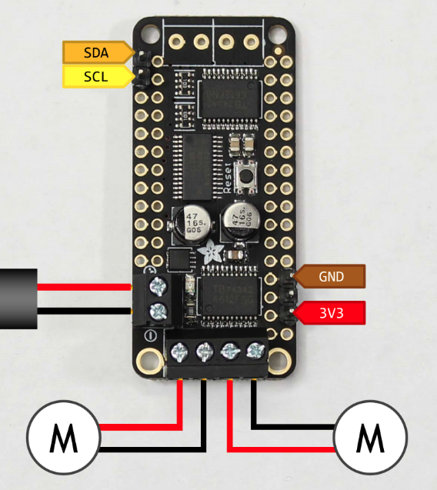
Motor Controller
Connect SDA and SCL to pins 3 and 5 respectively on the Nano’s 40-pin connector using female-to-female jumpers.
Cut off one of the USB Type A plugs and connect the red and black wires to + and – terminals.
Connect GND and 3V3 to pins 6 and 4 respectively on the Nano’s 40-pin connector using female-to-female jumpers.
Connect motor leads as indicated.

Slide 19
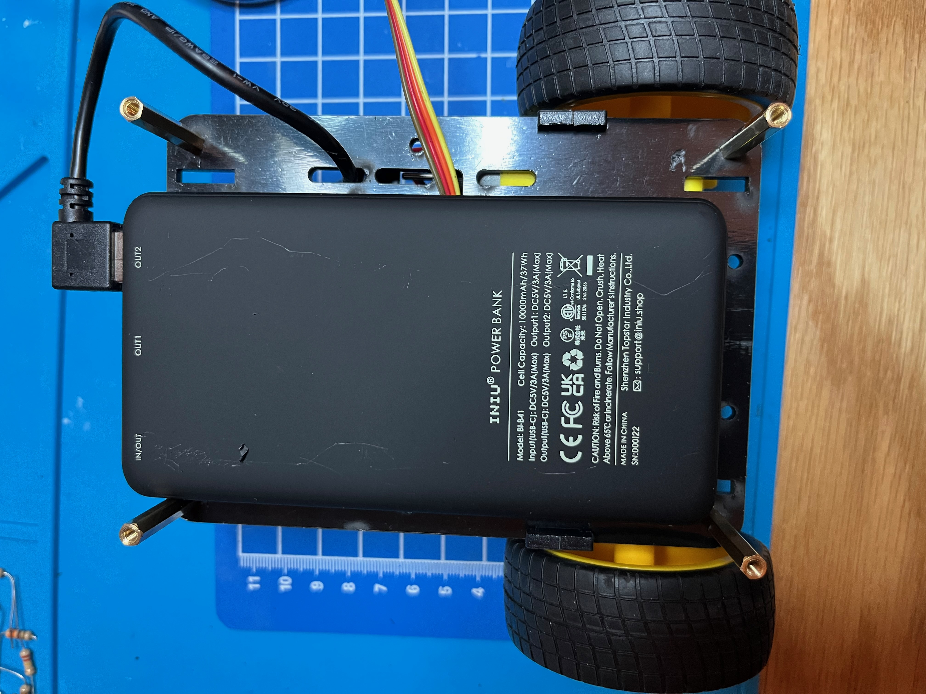
Top View of Bottom Plate
Thread USB cable and jumpers through slots in the bottom plate.
Secure power bank to the bottom plate using double-sided tape or other adhesive.
Attach long standoffs to corners of bottom plate.

Slide 20
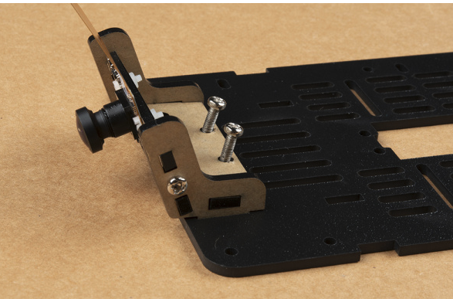
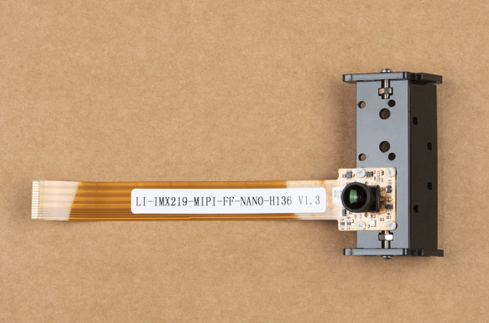
Attach Camera Module
Assemble camera bracket.
Attach camera module to bracket.
Secure camera bracket to top plate.

Slide 21
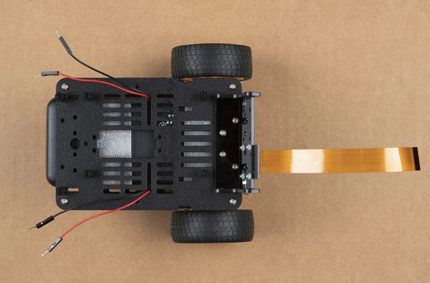
Top View of Top Plate
Thread wires through slots as needed.
Secure top plate to long standoffs using screws supplied in kit.
Prepare top plate for mounting Jetson Nano.

Slide 22
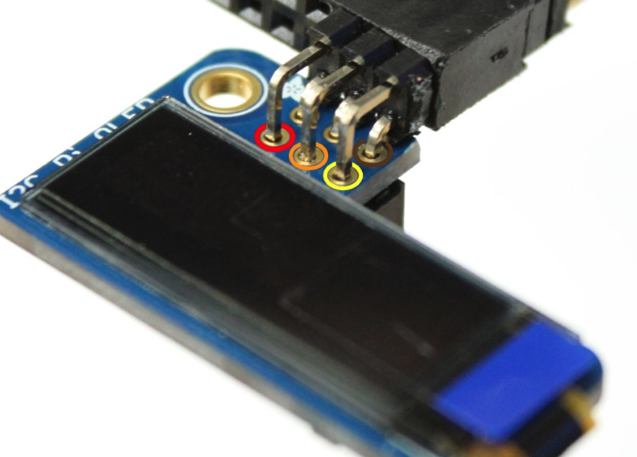
Prepare PiOLED Display
Solder right-angle header pins to PiOLED Display (this is to share the I2C pins with the OLED display and the motor controller board).

Slide 23
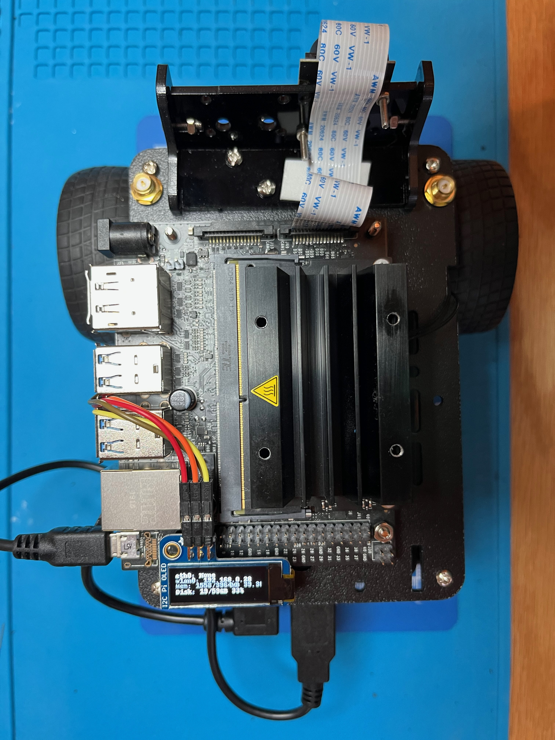
Top View
Mount Jetson Nano to top plate using plastic standoffs and screws.
Insert camera ribbon cable into slot connector on Nano.
Connect PiOLED to 40-pin connector and plug motor control jumpers into the soldered on right-angle header pins.
Plug micro-USB cable into Nano’s power supply port.
Attach Wi-Fi antenna(s) if applicable.

Slide 24
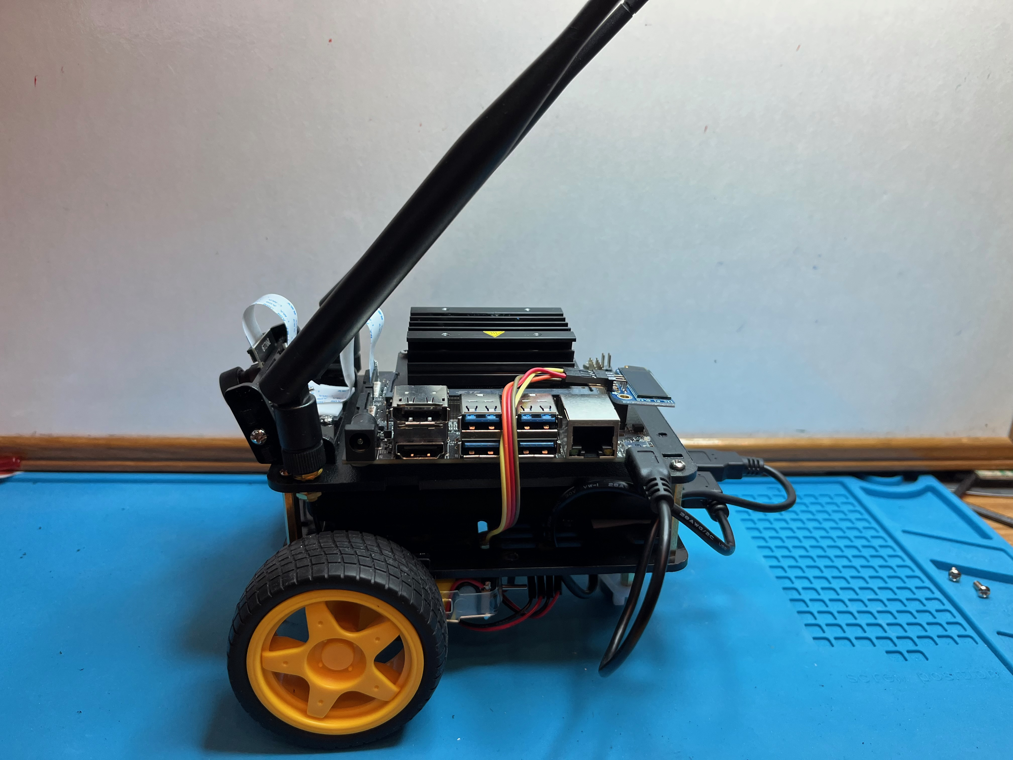
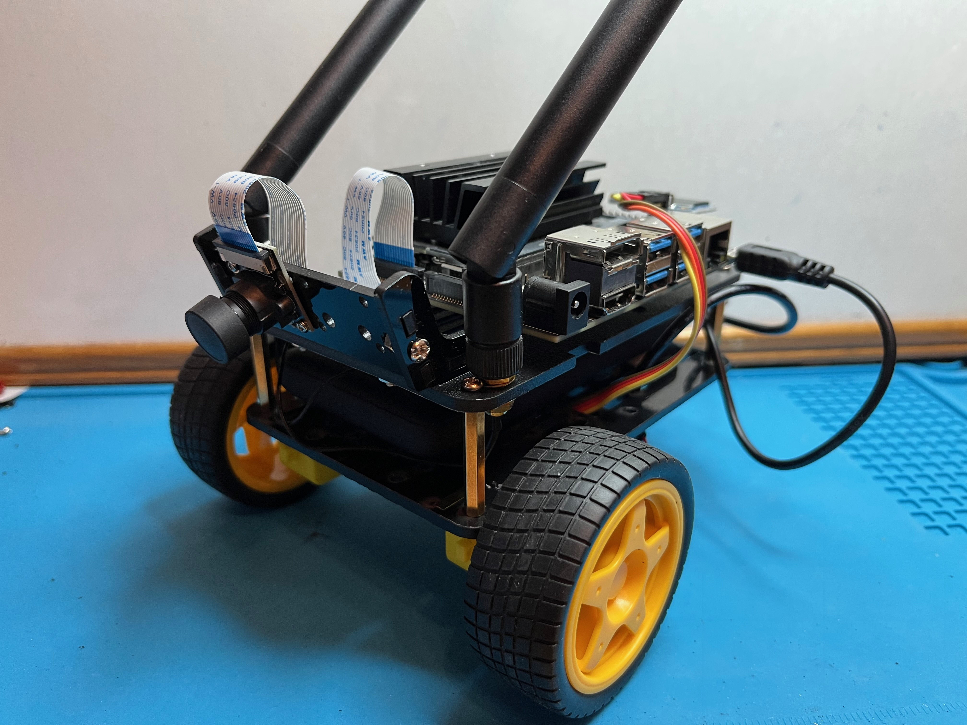
Fully Assembled JetBot!

Slide 25
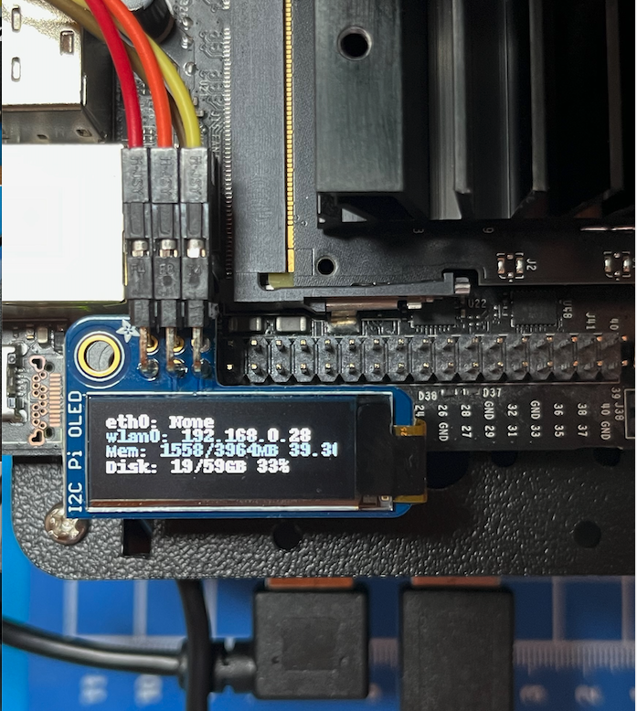
Power it Up!
Plug the USB cable from the Nano into the power bank.
Turn on the power bank.
After a minute or two, the OLED should display some data including the IP address assigned to the Nano.
Plug the USB cable from the motor controller into the power bank.

Slide 26
Time to Play!

Slide 27
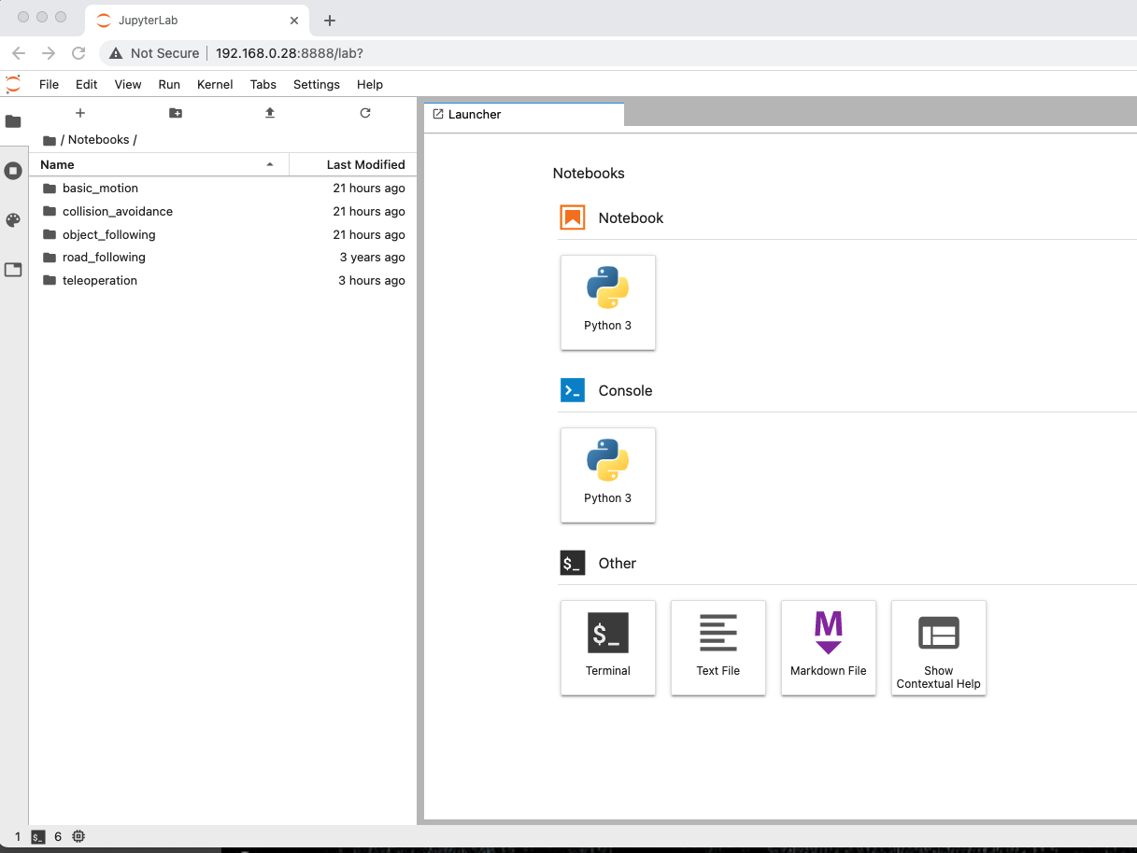
Connect to your JetBot
Open a browser on your laptop or desktop computer on the same Wi-Fi network as your JetBot.
Enter your JetBot’s IP address followed by :8888
Enter the password jetbot
You are connected to your JetBot and will see the opening screen of JupyterLab with several notebooks containing demo code for your JetBot.

Slide 28
Jupyter Notebooks and JupyterLab
Jupyter Notebook: The Classic Notebook Interface
The Jupyter Notebook is the original web application for creating and sharing computational documents. It offers a simple, streamlined, document-centric experience.
Notebooks can contain markdown, code, and output and can be organized to maximize the presentation of complex projects.
JupyterLab: A Next-Generation Notebook Interface
JupyterLab is the latest web-based interactive development environment for notebooks, code, and data. Its flexible interface allows users to configure and arrange workflows in data science, scientific computing, computational journalism, and machine learning. A modular design invites extensions to expand and enrich functionality.

Slide 29
Included Jupyter Notebooks
basic_motion – Lets you control your robot with simple python commands from your browser.
collision_avoidance – Use machine learning to train your JetBot to avoid obstacles in the environment.
object_following – Use a pre-trained model to allow your JetBot to detect common objects such as people, cups, dogs, etc.
road_following – Use an image regression data set to allow your JetBot to follow a road.
teleoperation – Drive your JetBot remotely using a gamepad and live streaming video.

Slide 30
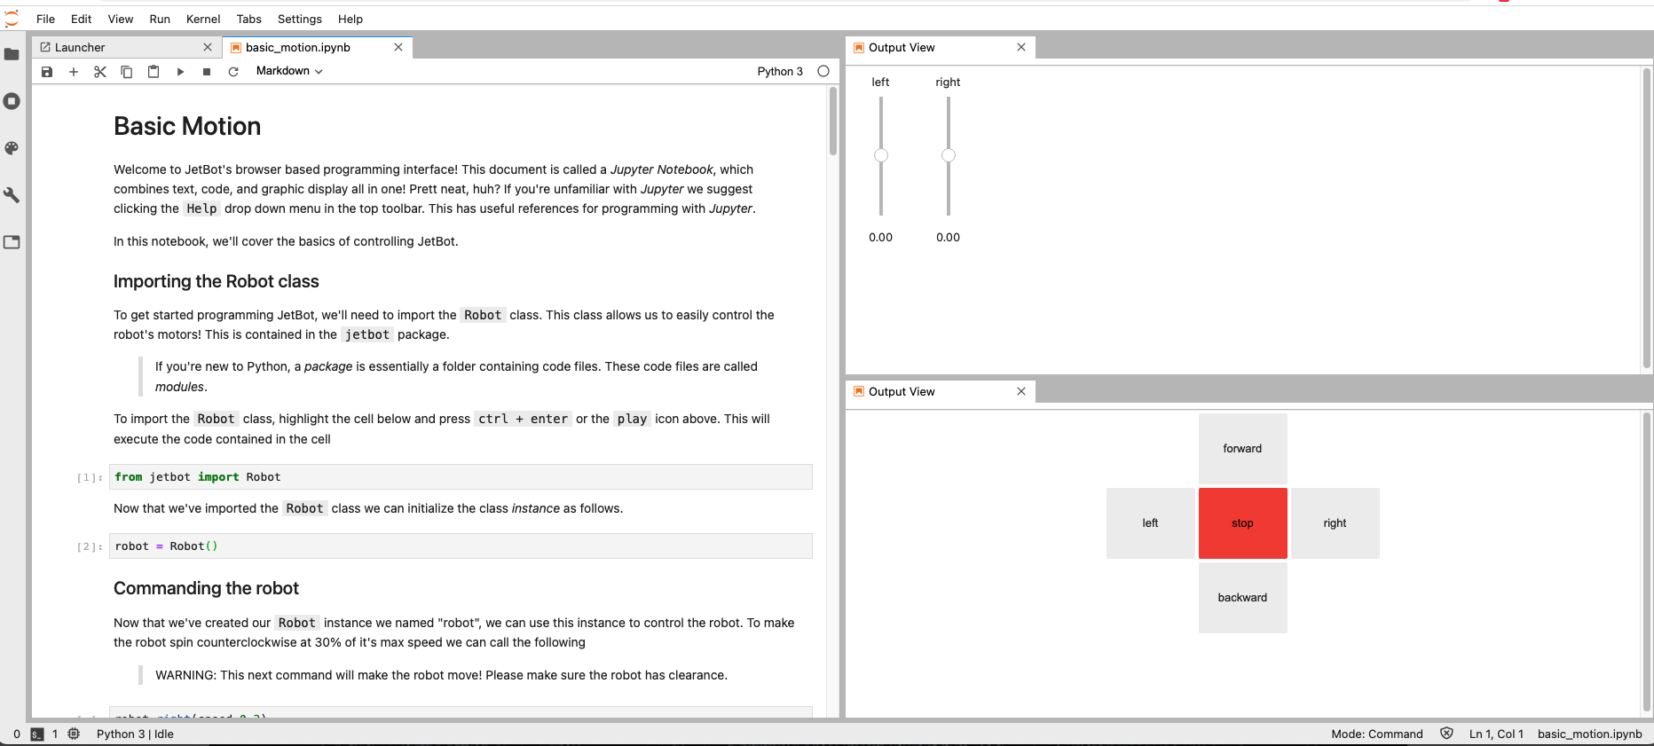
Sample Notebook – Basic Motion

Slide 31
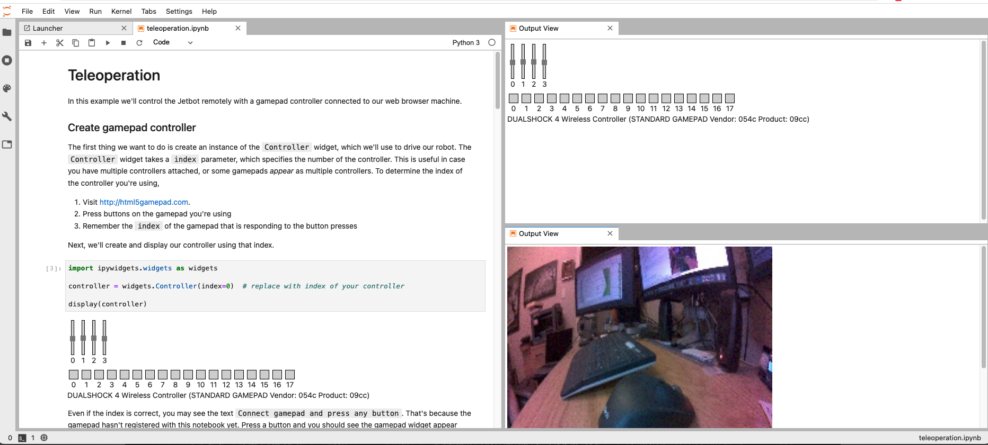
Sample Notebook – Teleoperation

Slide 32
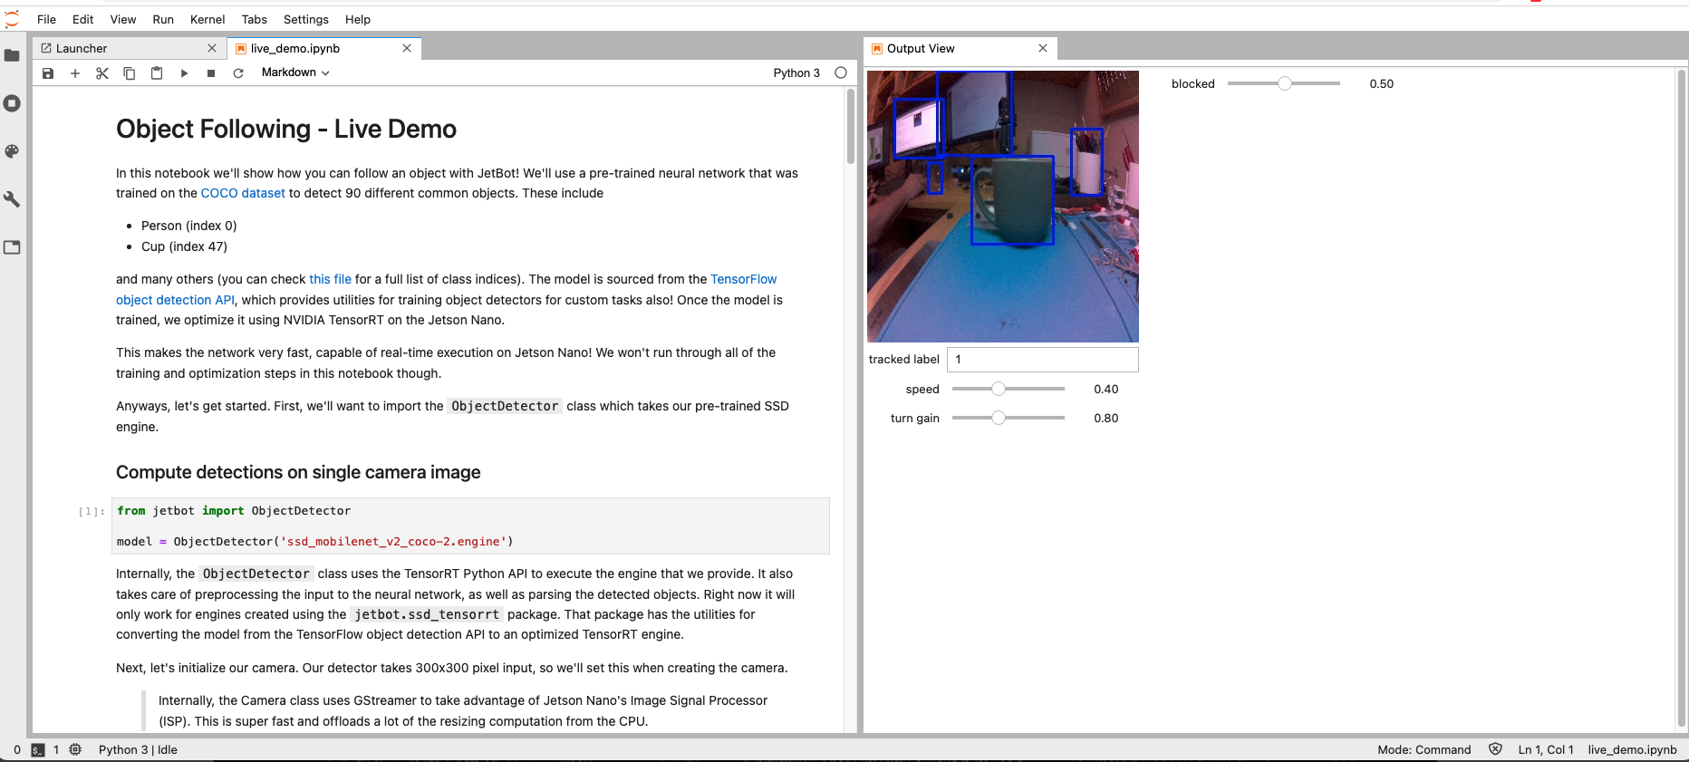
Sample Notebook – Object Following

Slide 33
Live Demo

